Slide 1

Web Application
Security
Privacy in the Digital Domain

Slide 2
Privacy: Overview

Slide 3
What is Privacy?
A fundamental human right.
Simply: people’s right to be left alone!
– Louis Brandeis, 1890
(Harvard Law Review)
Make their personal decisions
Live their lives secluded from public scrutiny
Stop their information from becoming known to people
other than those they choose.

Slide 4
UN Declaration of Human Rights
“No one shall be subjected to arbitrary interference with his privacy, family, home or correspondence, nor to attacks upon his honor and reputation. Everyone has the right to the protection of the law against such interference or attacks.”
See http://www.un.org/cyberschoolbus/humanrights/declaration/12.asp

Slide 5
Privacy in Digital Domain
Privacy is much more challenging when it comes to computers.
Digital Information is:
Easy to spread
Easy to leak
Hard to remove
You borrow a book:
Hardcopy → you will have it for a while.
Digital → possible to keep it forever and pass it to others.

Slide 6
Privacy in Internet
Internet threatens privacy
Google and Bing monitors all their searches
for search optimization, advertising.
Gmail and Hotmail collect a great deal of the world’s email traffic.
Have you heard about doubleclick.net?
Internet ad serving service, started in 1998.
$1.7 billion in 1999.
Bought by Google in 2007, for $3.1 billion.
Why? Collects data!
NSA, CSIS, the “Five Eyes” etc……

Slide 7
Privacy vs. Security
Privacy:
How to best meet user’s preference while handling their information
Customer-centric concept
Security:
How to protect information against malicious activities
Content-centric concept
Security is a component of privacy: security can be used as a tool for providing privacy

Slide 8
Privacy Legislation

Slide 9
Major Privacy Legislation: History
Department of Health Education and Welfare, 1973 (http://aspe.hhs.gov/datacncl/1973privacy/tocprefacemembers.htm)
Federal Trade Commission (FTC), 1998 (http://www.ftc.gov/reports/privacy3/fairinfo.htm)
Formal treatment of PII.
EU Directives on Data Protection, 1998 (http://www.cdt.org/privacy/eudirective/EU_Directive_.html)
Seven safe harbor principles!
Intended for organizations within the EU or US that store customer data!

Slide 10
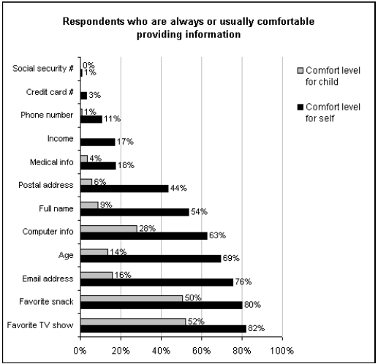
Personally identifiable information (PII)
Definition: Any information that identifies or locate someone
Examples: Name, address, license plate, account ID, IP address
Source: Cranor, Reagle,
Ackerman. “Beyond
Concern: Understanding
Net Users’ Attitudes About
Online Privacy”

Slide 11
Protection of PII
Collect only the personal information needed to perform duties
Inform people about the collection and about what purpose of using information.
Privacy Statement
Only use personal information for the purpose(s) for which it was collected or a consistent purpose
Enforcement
Don’t disclose personal information other than to the individual to whom it relates

Slide 12
Seven Safe Harbor Principles
Notice:
user should be clearly informed of how data is planned to be used
Choice:
user should be able to indicate privacy preferences before data is collected
Onward transfer:
sharing of information with third parties requires user’s permission
Access:
users should have access to read, verify and modify their information (can be supervised by the system)

Slide 13
Seven Safe Harbor Principles
Security:
security features should be applied to permit the protection of sensitive information
This is in fact “Confidentiality!”
Data integrity:
data should be checked to stay current, correct and not maliciously tampered with
Enforcement:
there should be a clear and conspicuous manner in which user can reach to address a privacy issue
See http://www.export.gov/safeharbor/

Slide 14
Other Privacy Legislation
Computer Fraud and Abuse Act (CFAA)
Health Information Portability Accountability Act (HIPAA)
Freedom of Information and Protection of Privacy (FIPPA)
Children’s Online Privacy Protection Act (COPPA)

Slide 15
Privacy Breach

Slide 16
Types of Invasion of Privacy
Annoying invasion:
Not a long-term damage, just annoying
Example:
Spams or phone calls that use personal contact info to offer new services
Malicious invasion:
Unethical or illegal benefit from sensitive information
Example:
Selling personal information (e.g., credit card) to thieves and privacy violators

Slide 17
Techniques for Breeching Privacy
Data Merging
Data Matching
Data Mining

Slide 18
Data Merging
Customer gives information to different organizations.
This is done voluntarily
What if information is transferred and merged between organizations?
Merging a number of databases:
Car registry with driver’s license
Medical record with health insurance
When data is merged, customer looses control of its privacy!
Most Canadians can be uniquely identified from DoB and Postal Code!
In the US, unique identification is done by DoB, gender, Zip code!

Slide 19
Data Matching
Information on a discrete database is used to match similar records on another database.
Matching is different from merging!
Example: Superbowl 2001
Facial recognition software was used to scan the faces of individuals entering the stadium. The digitized facial images were then instantly matched against images in a centralized database to suspected criminals and terrorists

Slide 20
Data Mining
Collected information is mined to uncover other pieces of information:
behaviors, habits, etc.
Facebook examples:
Number of received wall posts → DoB.
Liked pages/posts → interests → Ads
Typically not concerned about individual records
But can be possibly used in this way too!

Slide 21
Building Privacy In

Slide 22
Privacy Specification Template
Data-Specific Privacy:
How is the data used and by whom?
How long is the data stored?
What value does the user gain from this?
Does the user have the ability to view and modify the data?
Is the user’s permission explicitly given before storing the data?
What end-user settings apply to how the data is stored and used?
Is access to the data protected?
Is the data encrypted?
With which third parties will the data be shared?

Slide 23
Privacy Specification Template
Client-side component:
Does your feature send data to the Web for any reason?
Describe in detail:
the contents of the data that is sent,
when the data is sent,
where the data is sent, and
why the data is sent.
Does the user have the ability to select whether they want this data sent?
If so, what is the default?
If the default is not “off,” explain why “on” is acceptable.

Slide 24
Privacy Specification Template
Web service component:
Does the Web service have a privacy statement associated with it?
Where is it archived?
Is it registered with the corporate privacy group?
Describe the contents of any cookies that you create and their purpose.
Describe the contents of any logs that you keep.
Include any unique IDs.

